Slide 1
WELCOME

Slide 2
Application of the Hyperbola in Cooling Tower
Submitted by
Submitted to
B M Shahria Alam
ID: 2021-3-60-016
Student number: 15
Department of CSE
East West University
Dr. A. K. M. Nazimuddin
Senior Lecturer
Department of MPS
East West University

Slide 3
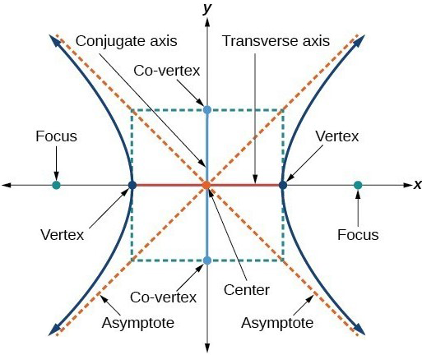
Application of the Hyperbola
Hyperbolas are made up of two branches that are shaped like a parabola. It has a vertex and a focus in each branch, which serve to define the hyperbola. We also have two asymptotes, which define the shape of the branches.

Slide 4
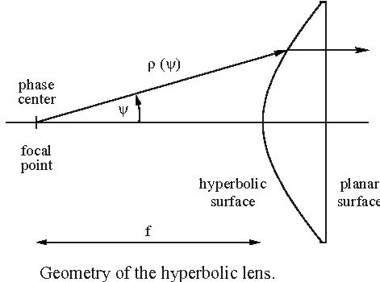
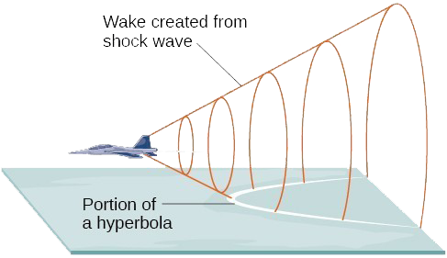
Some uses of application of the hyperbola in real life
01
Nuclear Power Plant
02
Satellite
03
Radio
04
Hyperbolic Light
05
Lenses
06
Monitors

Slide 5
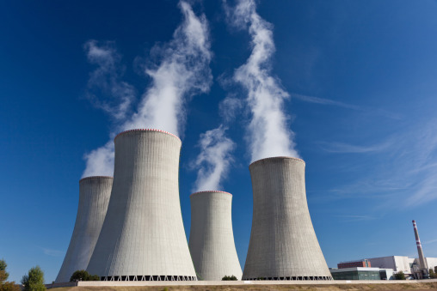
Cooling Tower
The application of hyperbola is used for the design for all nuclear power plant cooling towers and some coal-fired power plants.
Cooling Tower

Slide 6
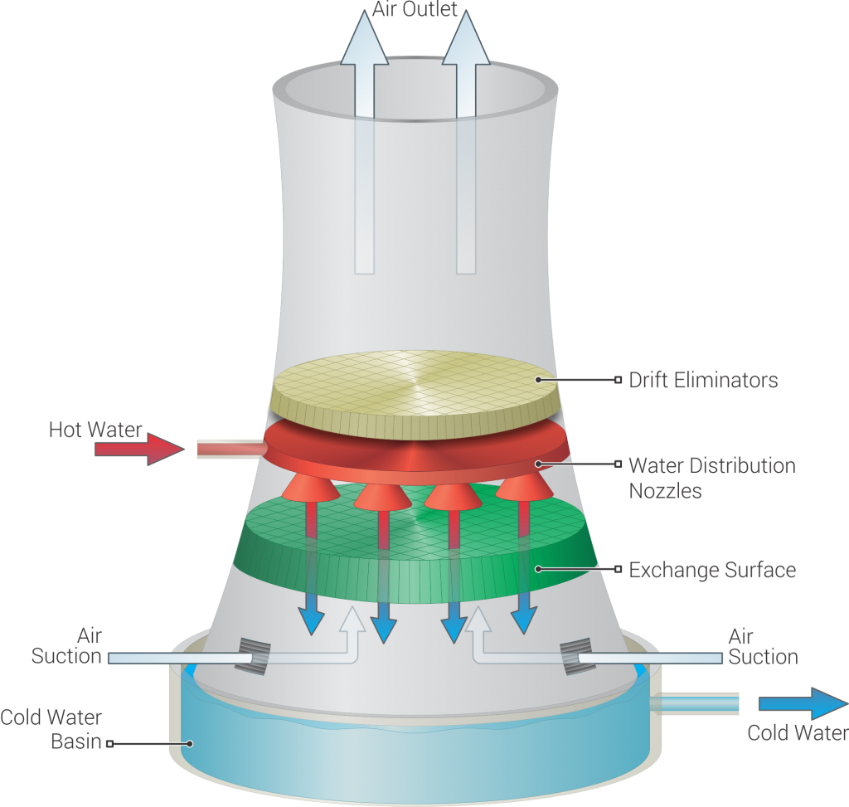
Cooling Tower
The design of cooling towers mainly focuses on two problems:
i) The structure must be strong enough to withstand strong winds.
ii) The towers should be built with the least amount of material possible.
The hyperbolic shape of the cooling towers solves both problems. These towers are very resistant.
Cooling Tower

Slide 7
Example:
A design for a cooling tower project is shown in Figure. Find the equation of the hyperbola
that models the sides of the cooling tower. Assume that the centre of the hyperbola indicated
by the intersection of dashed perpendicular lines in the figure is the origin of the coordinate
plane.

Slide 8
Solve:
We are assuming the centre of the tower is at the origin, so we can use the standard form of hyperbola and that is:
-----------(1)
where the branches of the hyperbola form the sides of the cooling tower. We must find the values of and to complete the model.
First, we find . Recall that the length of the transverse axis of a hyperbola is 2a. This
length is represented by the distance where the sides are closest, which is given as 40 meters.
So , 2a = 40.
Therefore, a = 20; so, .
Given,
(x, y) = (30, 67.082)

Slide 9
Therefore,
Putting the value of and in equation (1)
This is our required equation of the hyperbola.

Slide 10
Thank You

